Slide 1


Slide 2


Florida Afterschool Network

Slide 3

Florida Afterschool Quality Standards
The standards are organized in seven (7) categories.
Administration and Organization
Program Management and Staff
Communication and Interaction
Program Structure and Activities
Health, Safety and Nutrition
Program Environment
Family and Community Involvement

Slide 4

Afterschool & Summer Learning
State of Afterschool & Summer Learning in Florida Report
Benefits of Afterschool
  Mental Health
  Increase School Attendance
  Decrease Risky Behavior
  Preventing Summer Slide
  Creating Tomorrow’s Workforce
  Supporting working families with a Safe place

Slide 5
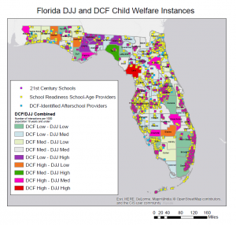
Afterschool & Summer Learning
State of Afterschool & Summer Learning in Florida Report
Connections to decreasing
Juvenile Crime & Child Welfare

Slide 6




STEM & Entrepreneurship

